Slide 1
Data Mining: Similarity Measures
Tom Heskes

Slide 2
Similarity and Dissimilarity
Similarity
Numerical measure of how alike two data objects are.
Is higher when objects are more alike.
Often falls in the range [0,1].
Dissimilarity
Numerical measure of how different two data objects are.
Lower when objects are more alike.
Minimum dissimilarity is often 0.
Upper limit varies.
Proximity refers to a similarity or dissimilarity

Slide 3

Similarity/Dissimilarity for Simple Attributes
Nominal attributes $p$ and $q$ $d=\left\{\begin{aligned}0, p=q \\ &1, p≠q\end{aligned}\right. s=1−d$
Ordinal attributes: map n distinct values to integers from $0$ to $n−1$ $d=\frac{\left|p−q\right|}{n−1} s=1−d$
Interval or ratio attributes: $d=\left|p−q\right| s=\frac{1}{1+d}$

Slide 4

Euclidean distance
Euclidean distance between two objects $p$ and $q$ with $n$ attributes $d\left(p,q\right)=\sqrt{\sum_{k=1}^{n}{{\left(p_{k}−q_{k}\right)}^{2}}}$
Distance of a ruler
Standardization is necessary, if scales differ

Slide 5
Euclidean Distance
distance matrix

Slide 6
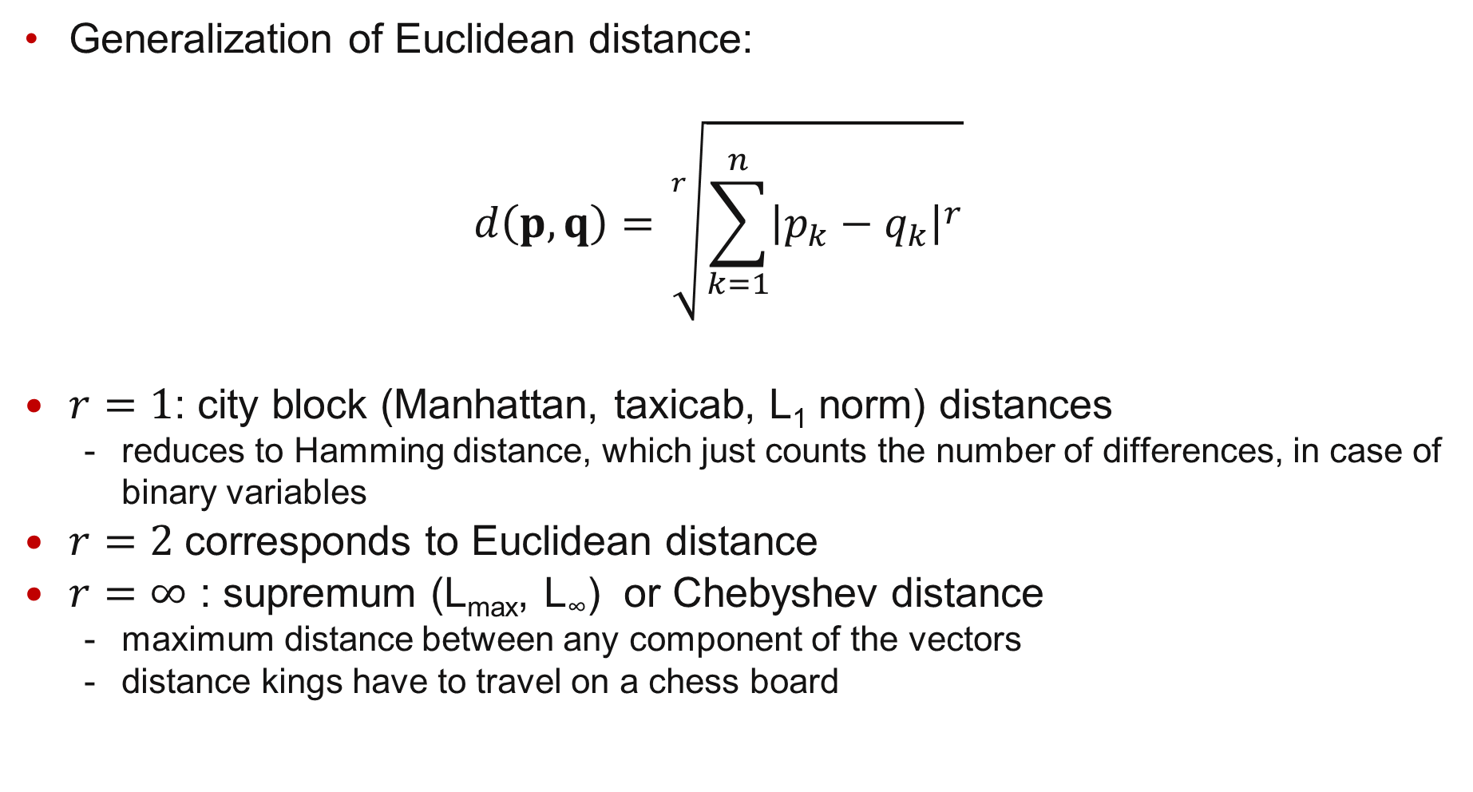
Minkowski distance
Generalization of Euclidean distance: $d\left(p,q\right)=\sqrt[r]{\sum_{k=1}^{n}{{\left|p_{k}−q_{k}\right|}^{r}}}$
$r=1$: city block (Manhattan, taxicab, L₁ norm) distances
reduces to Hamming distance, which just counts the number of differences, in case of binary variables
$r=2$corresponds to Euclidean distance
$r=∞$ : supremum (L_{max}, L∞) or Chebyshev distance
maximum distance between any component of the vectors
distance kings have to travel on a chess board

Slide 7
Manhattan Distance (r = 1)
distance matrix

Slide 8
Supremum Distance (r = ∞)
distance matrix

Slide 9
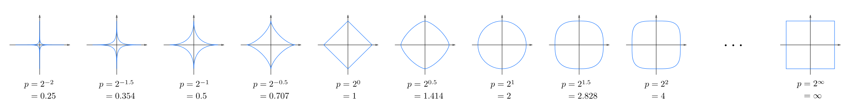
Unit circle

Slide 10
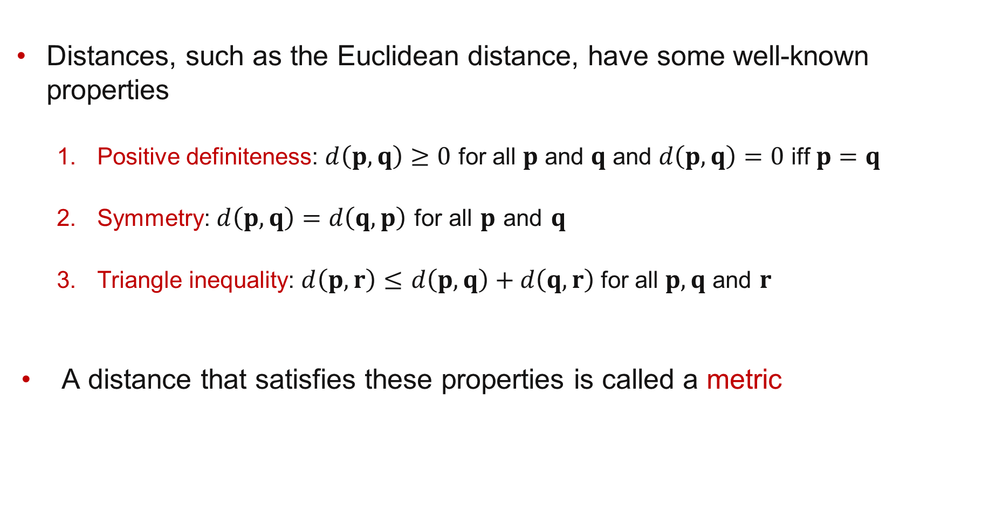
Common properties of a distance
Distances, such as the Euclidean distance, have some well-known properties
Positive definiteness: $d\left(p,q\right)≥0$ for all $p$ and $q$ and $d\left(p,q\right)=0$ iff $p=q$
Symmetry: $d\left(p,q\right)=d\left(q,p\right)$for all $p$ and $q$
Triangle inequality: $d\left(p,r\right)≤$ $d\left(p,q\right)+d\left(q,r\right)$for all $p,q$ and $r$
A distance that satisfies these properties is called a metric

Slide 11
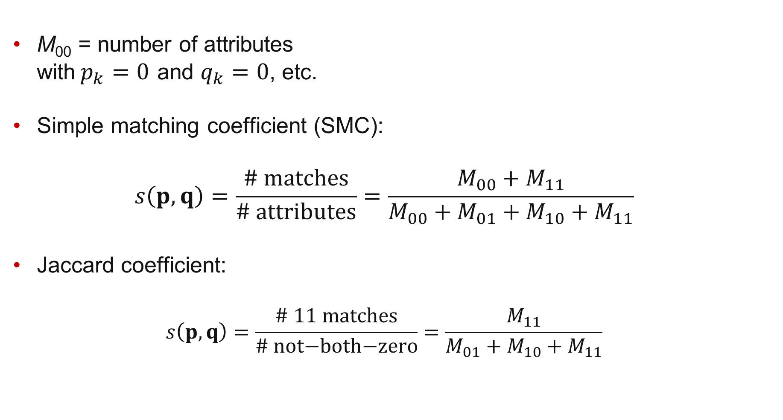


Similarity Between Binary Vectors
$$p$$
M₀₀ = number of attributes with$p_{k}=0$ and $q_{k}=0$, etc.
Simple matching coefficient (SMC): $s\left(p,q\right)=\frac{\text{\# }\text{matches}}{\text{\# }\text{attributes}}=\frac{M_{00}+M_{11}}{M_{00}+M_{01}+M_{10}+M_{11}}$
Jaccard coefficient: $s\left(p,q\right)=\frac{\text{\# }\text{11 }\text{matches}}{\text{\# }\text{not}\text{−}\text{both}\text{−}\text{zero}}=\frac{M_{11}}{M_{01}+M_{10}+M_{11}}$
$$q$$

Slide 12
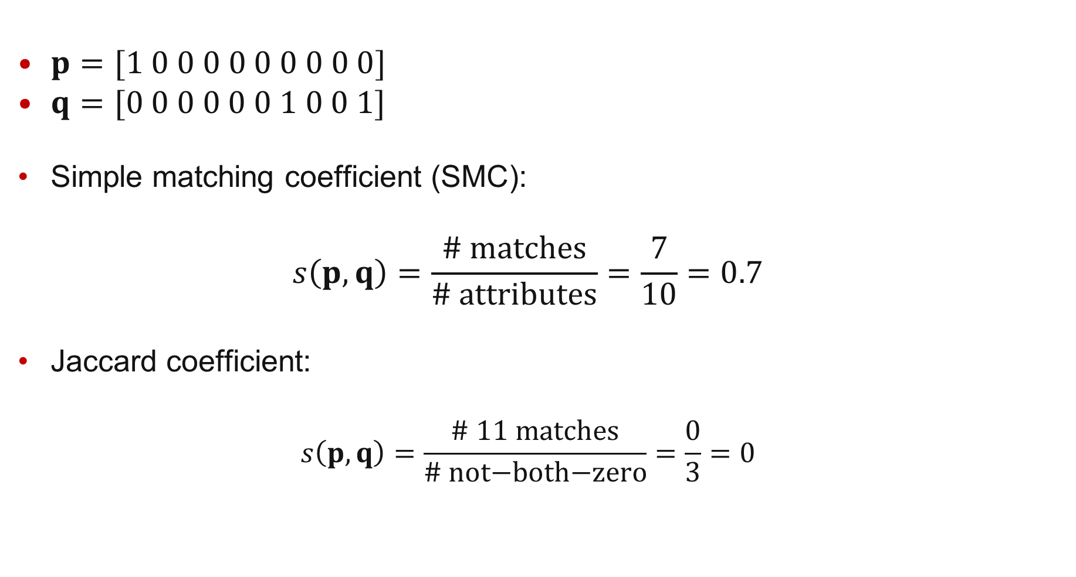
SMC versus Jaccard
$$p$$
$p=[1 0 0 0 0 0 0 0 0 0]$
$q=[0 0 0 0 0 0 1 0 0 1]$
Simple matching coefficient (SMC): $s\left(p,q\right)=\frac{\text{\# }\text{matches}}{\text{\# }\text{attributes}}=\frac{7}{10}=0.7$
Jaccard coefficient: $s\left(p,q\right)=\frac{\text{\# }\text{11 }\text{matches}}{\text{\# }\text{not}\text{−}\text{both}\text{−}\text{zero}}=\frac{0}{3}=0$
$$q$$

Slide 13

Cosine Similarity
Specifically for documents vectors $s\left(p,q\right)=\frac{p∙q}{\left\|p\right\|\left\|q\right\|}$
With inner product $p∙q=\sum_{k=1}^{n}{p_{k}q_{k}}$
And vector length $\left\|p\right\|=\sqrt{p∙p}$

Slide 14
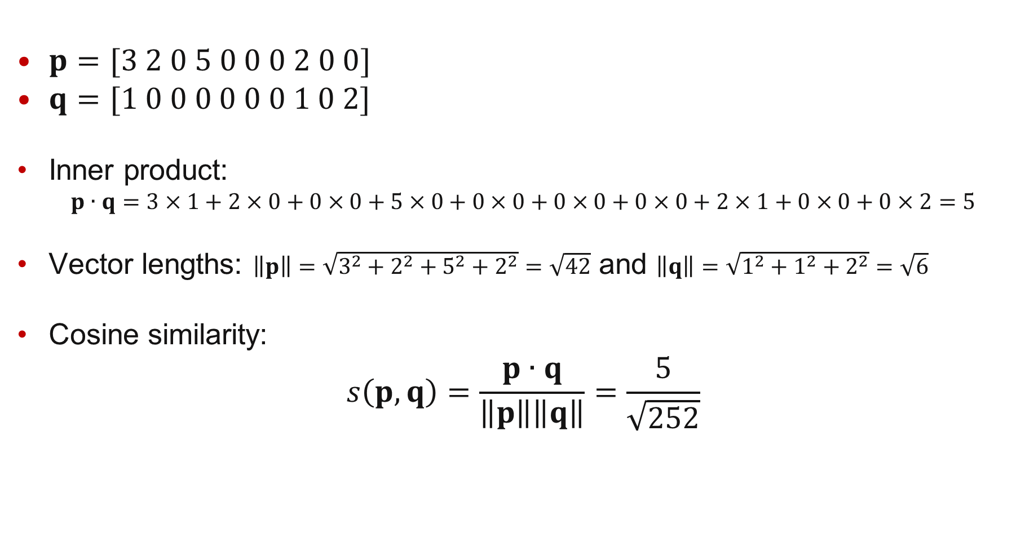
Cosine Similarity Example
$p=[3 2 0 5 0 0 0 2 0 0]$
$q=[1 0 0 0 0 0 0 1 0 2]$
Inner product: $p∙q=3×1+2×0+0×0+5×0+0×0+0×0+0×0+2×1+0×0+0×2=5$
Vector lengths: $\left\|p\right\|=\sqrt{3^{2}+2^{2}+5^{2}+2^{2}}=\sqrt{42}$ and $\left\|q\right\|=\sqrt{1^{2}+1^{2}+2^{2}}=\sqrt{6}$
Cosine similarity: $s\left(p,q\right)=\frac{p∙q}{\left\|p\right\|\left\|q\right\|}=\frac{5}{\sqrt{252}}$

